Slide 1

Cloud Service Center Dashboard- 8/4/2020
Projects
Hours & Forecast
Migration
4
Upcoming
2
See next slide for details
BassPro should be ramping up in a few weeks, they’ve added some new apps and servers to the scope
Elekta will likely have to be reduced in a week or two until migrations get started
Providence should start ramping up in the next week or two
Sandler Travis (STTAS)
Bass Pro
Elekta
Providence
Hussmann (LZ)
Flow Intl (LZ)
Landing Zone
Rolling Off / On Hold
1
Estee
Stats
-
 | 2 weeks ago | Last Week | This Week | Next Week | 2 weeks out | 3 weeks out
Projects | 4 | 4 | 4 | 6 | 6 | 7
Mig VMs | 1 | 6 | 34 | 36 | N/P | N/P
Mig DBs | 0 | 0 | 0 | N/P | N/P | N/P
Other Work | 1 | 0 | 0 | N/P | N/P | N/P
34
Resources Scheduled
To Migrate
This week so far
Support
-
0
Updates / New Items
Blockers / Challenges
Improvement Items
Service Expansion
  In-Progress:
  Azure VMware Solution
  SQL Server/DB Migration Enhancements
  Managed Services Transition
  ALZ Engineering/Deployment
  WVD Quickstart Deployments
Estee – Awaiting change freeze to be lifted to perform partial DR test and handover. Marshall taking lead on this one. Scheduled for end of August.
Bass Pro still moving slowly but should ramp up when they give us control of the migrations.
Migration automation
  Full end to end automation
  Additional post-migration operations setup automation
  Getting the team to actually use the automation!
WVD deployment process documentation, scripts, automation, training

Slide 2
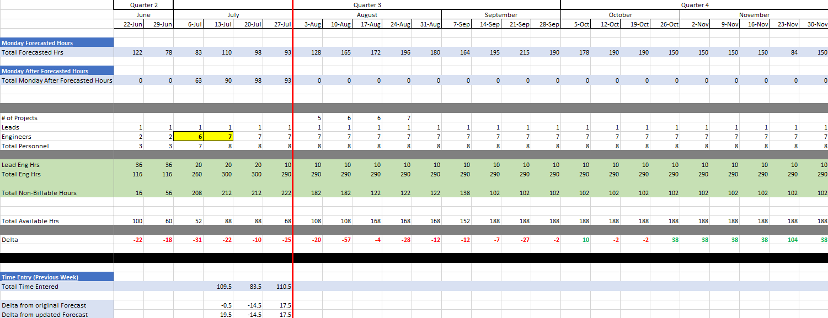

Slide 3
Cloud Service Center Metrics
CMC Utilization %
Forecast
Joe/Kyle billable 5-10hrs/wk+
Total Migrated Resources
CMC Utilization %
Actual Billed
Work Items by Client

